Slide 1
Annex 19 Safety Management 1st edition
ISM
Integrated Safety Management
24 May 2013 – initial version

Slide 2
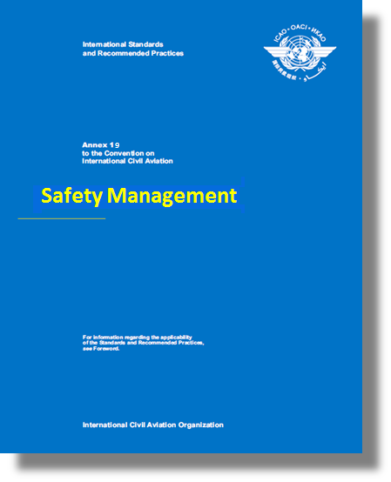
Why a new Annex?

Slide 3
Why a New Annex?
The ICAO High-level Safety Conference (HLSC) held in 2010 provided the impetus for the development of a new Annex dedicated to Safety Management.
ICAO doc 9335 refers
The Conference concluded that safety management processes under the direct responsibility of States that are critical to civil aviation safety should be contained in a single Annex:
Including the State Safety Programme (SSP) framework and the 8 critical elements of a safety oversight system;
Covering general and business aviation activities; and
Retaining the safety management system (SMS) requirements specific to one area of activities in individual Annexes.
Notes:
High-level Safety Conference 2010 - RECOMMENDATION 2/5
ICAO should develop, in close collaboration with States, international and national organizations, a new Annex dedicated to safety management responsibilities and processes which would address the safety management responsibilities of States framed under the State Safety Programme (SSP).
The new Safety Management Annex should facilitate the provision of State and air carrier safety information to the travelling public, in addition to specifying the high level safety responsibilities of States.

Slide 4
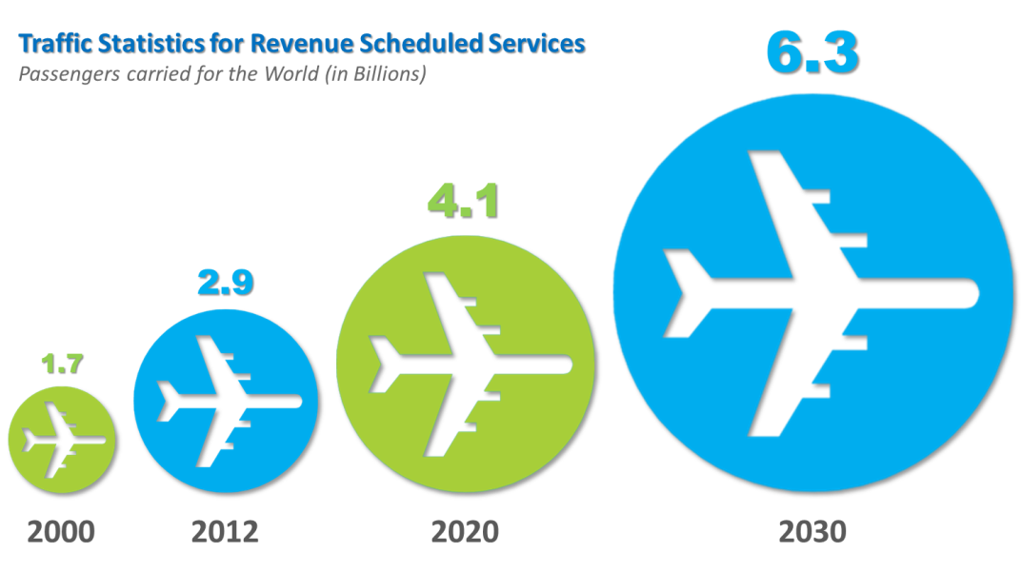
Why a New Annex?
With air traffic projected to double in the next 15 years, safety risks must be addressed proactively to ensure that this significant capacity expansion is carefully managed and supported through strategic regulatory and infrastructure developments.
An Annex dedicated to safety management will re-enforce the role played by the State in managing safety at the State level, stressing the concept of overall safety performance in all domains, in coordination with service providers.

Slide 5
Process for the development of the new Annex
Annex 19 – Safety Management

Slide 6
Annex 19 – Safety Management
In response to the HLSC 2010 recommendation 2/5, the Air Navigation Commission recommended that the new Annex be developed in 2 phases:
Phase 1 involved the consolidation of existing safety management provisions currently contained in as many as 6 different Annexes, into a single new Annex.
The development of enhanced requirements will become the focus of Phase 2, once the new Annex (1st edition) becomes applicable.
Notes:
As of May 2013, the existing safety management requirement are contained in the following Annexes:
Annex 1 — Personnel Licensing;
Annex 6 — Operation of Aircraft, Part I — International Commercial Air Transport — Aeroplanes, Part II — International General Aviation — Aeroplanes and Part III — International Operations — Helicopters;
Annex 8 — Airworthiness of Aircraft;
Annex 11 — Air Traffic Services;
Annex 13 — Aircraft Accident and Incident Investigation; and
Annex 14 —Aerodromes, Volume I — Aerodrome Design and Operations

Slide 7
Annex 19 – Safety Management
This approach was intended to expedite the creation of the new Annex, while maintaining continuity with current SSP and SMS requirements.
The ICAO Council approved this 2-phase approach.
The Air Navigation Commission (ANC) established a Panel of Experts, the Safety Management Panel (SMP), for the development of Annex 19.
Notes:
As of April 2013, the existing safety management requirement are contained in the following Annexes:
Annex 1 — Personnel Licensing;
Annex 6 — Operation of Aircraft, Part I — International Commercial Air Transport — Aeroplanes, Part II — International General Aviation — Aeroplanes and Part III — International Operations — Helicopters;
Annex 8 — Airworthiness of Aircraft;
Annex 11 — Air Traffic Services;
Annex 13 — Aircraft Accident and Incident Investigation; and
Annex 14 —Aerodromes, Volume I — Aerodrome Design and Operations

Slide 8
Annex 19 – Safety Management
Therefore, Phase 1 was limited to:
The identification of existing provisions to serve as the basis for Annex 19, 1st edition;
With modification, as necessary, for clarity or harmonization.
Phase 1 was completed in less than 2 years with the ICAO Council adoption on 25 February 2013.
Annex 19, 1st edition has an applicability date of 14 November 2013*.
* Independently of the applicability date of Annex 19, the existing Standards and Recommended Practices (SARPS) retain their original applicability, dating from 2001 onwards.

Slide 9
What is the basis for Annex 19, 1st edition?
Annex 19 – Safety Management

Slide 10
Basis of Annex 19, 1st edition
The transfer of overarching safety management provisions from the following Annexes:
Annex 1 — Personnel Licensing;
Annex 6 — Operation of Aircraft, Part I — International Commercial Air Transport — Aeroplanes, Part II — International General Aviation — Aeroplanes and Part III — International Operations — Helicopters;
Annex 8 — Airworthiness of Aircraft;
Annex 11 — Air Traffic Services;
Annex 13 — Aircraft Accident and Incident Investigation; and
Annex 14 —Aerodromes, Volume I — Aerodrome Design and Operations
Note: Independently of the applicability date of Annex 19, these SARPS retain their original applicability, dating from 2001 onwards.

Slide 11
Basis of Annex 19, 1st edition (cont.)
The adaptation of Annex 6, Part I, Appendix 5 and Annex 6, Part III, Appendix 1, Safety oversight of Air Operators.
The duplication of Annex 13, Attachment E, Legal guidance for the protection of information from safety data collection and processing systems.
Notes:
“Transfer” to Annex 19 means that the provision no longer exists in the original Annex.
“Duplication” means that the provision has been copied into Annex 19 and has been kept in the original Annex (with amendment, as necessary).

Slide 12
Basis of Annex 19, 1st edition
Sector-specific safety management provisions were retained in their appropriate Annexes.
Examples include:
Annex 1 (1.2.4.2) - basic safety management principles applicable to the medical assessment process of license holders; and
Annex 6, Part I and III - the flight data analysis programme is part of the aeroplane or helicopter operator’s SMS.
Notes:
“Transfer” to Annex 19 means that the provision no longer exists in the original Annex.
“Duplication” means that the provision has been copied into Annex 19 and has been kept in the original Annex (with amendment, as necessary).
As a result of the adoption of Annex 19, consequential amendments to Annexes 1 (Amdt. 171), 6, Part I (Amdt. 37), II (Amdt. 32) and III (Amdt. 18), 8 (Amdt. 104), 11 (Amdt. 49), 13 (Amdt. 14) and 14, Volume I (Amdt. 11) have also been adopted.

Slide 13
Basis of Annex 19, 1st edition
As a result of the transfer of the overarching safety management provisions to Annex 19, consequential amendments to existing Annexes were adopted by the ICAO Council, as follows:
Amendment 171 to Annex 1,
Amendment 37 to Annex 6, Part I,
Amendment 32 to Annex 6, Part II,
Amendment 18 to Annex 6, Part III,
Amendment 104 to Annex 8,
Amendment 49 to Annex 11,
Amendment 14 to Annex 13; and
Amendment 11 to Annex 14, Volume I.
Notes:
“Transfer” to Annex 19 means that the provision no longer exists in the original Annex.

Slide 14
Detailed content of Annex 19, 1st edition
Annex 19 – Safety Management

Slide 15
Annex 19, 1st edition - Overview
CHAPTER 1 – Definitions
CHAPTER 2 – Applicability
CHAPTER 3 – State safety management responsibilities
CHAPTER 4 – Safety management system (SMS)
CHAPTER 5 – Safety data collection, analysis and exchange
APPENDIX 1 –State safety oversight system
APPENDIX 2 – SMS Framework
ATTACHMENT A – SSP Framework
ATTACHMENT B – Legal guidance for the protection of information from safety data collection and processing systems

Slide 16
Annex 19, 1st edition - Structure
CHAPTER 1 – Definitions
Includes 12 existing definitions and 6 new definitions specific to the management of safety.
CHAPTER 2 – Applicability
The Standards and Recommended Practices (SARPs) are applicable to safety management functions related to, or in direct support of, the safe operation of aircraft

Slide 17
Annex 19, 1st edition - Structure
CHAPTER 3 – State Safety Management Responsibilities
This chapter outlines safety management responsibilities directly applicable to the State, including the SMS requirements be implemented by the following service providers* (as described in the relevant Annexes):
Approved training organizations;
Operators of aeroplanes or helicopters authorized to conduct international commercial air transport;
Approved maintenance organizations providing services to operators as described in bullet 2;
Organizations responsible for the type design or manufacture of aircraft;
Air traffic services (ATS) providers, and;
Operators of certified aerodromes.
* For the purposes of Annex 19, the term “service provider” refers to the list above.

Slide 18
Annex 19, 1st edition - Structure
CHAPTER 3 – State Safety Management Responsibilities (cont.)
In particular, it addresses the elements of the State Safety Programme (SSP) and the State safety oversight Standards, respectively described in Attachment A (SSP framework) and Appendix 1 (State safety oversight system).

Slide 19
Annex 19, 1st edition - Structure
CHAPTER 4 – Safety Management System (SMS)
Outlines the safety management responsibilities of service providers, described in Appendix 2 (SMS framework);
Also includes the safety management responsibilities of international general aviation operators, conducting operations of large or turbojet aeroplanes.

Slide 20
Annex 19, 1st edition - Structure
CHAPTER 5 – Safety Data Collection, Analysis and Exchange
Outlines the specifications to support safety management activities by collection and analysis of safety data and by exchange of safety information, as part of the SSP.
Complemented by Attachment B - Legal guidance for the protection of information from safety data collection and processing systems.

Slide 21
What is new in Annex 19, 1st edition?
Annex 19 – Safety Management

Slide 22
What is new in Annex 19, 1st edition? (1)
The following 4 changes establish new provisions:
The SMS framework now applies to organizations responsible for the type design and manufacture of aircraft.
The four components of the SSP framework are elevated to the status of Standard in chapter 3
The State Safety Oversight (Appendix 1) are applicable to the oversight of all product and service providers; and
The Safety Data Collection Analysis and Exchange (Chapter 5) and the Legal Guidance for the Protection of Safety Information from Safety Data Collection and processing systems (Attachment B) complement the SSP.

Slide 23
What is new in Annex 19, 1st edition? (2)
The SMS framework now applies to organizations responsible for the type design and manufacture of aircraft:
Annex 8 had already established SMS provisions applicable to these service providers and the SMS framework was expected to be introduced in the next amendment in any case.
The following four components of the SSP framework were elevated to the status of Standard in chapter 3:
State Safety policy and objectives
State Safety Risk Management
State Safety assurance
State Safety promotion

Slide 24
What is new in Annex 19, 1st edition? (3)
The State Safety Oversight (Appendix 1) are applicable to the oversight of all product and service providers.
These Standards, more commonly known as the Critical Elements (CEs), are not really new to States:
They had been already introduced in Annex 6, Parts I and III; and
States have already signed MoUs with ICAO, introducing the use of the 8 CEs as the foundation of the Universal Safety Oversight Audit Programme (USOAP)

Slide 25
What is new in Annex 19, 1st edition? (4)
The Safety Data Collection Analysis and Exchange (Chapter 5) and the Legal Guidance for the Protection of Safety Information from Safety Data Collection and processing systems (Attachment B) are complementary to the SSP.
These provisions, transferred from Annex 13, provide the necessary foundation for the collection, protection, analysis and exchange of safety data to complement the SSP provisions.

Slide 26
What are the benefits of Annex 19?
Annex 19 – Safety Management

Slide 27
Benefits of Annex 19
Highlights the importance of safety management at the State level;
Enhances safety by consolidating safety management provisions applicable to multiple aviation domains
Facilitates the evolution of safety management provisions;
An opportunity to further promote the implementation of SMS and SSP provisions; and
A process established to analyze feedback received regarding Annex 19 and safety management implementation.

Slide 28
Cost impact of Annex 19, 1st edition
Annex 19 – Safety Management

Slide 29
Cost Impact of Annex 19, 1st edition
The overall cost impact is light because Annex 19 is mostly based on existing provisions gradually introduced since 2001.
Impact to the States:
Administrative work for the review and amendment of existing legislation and regulations;
Update to references to existing Annex provisions;
Notification of differences to Annex 19, if any (SL 8/3 13/30 refers).
Impact to the Service providers and international general aviation operators:
Updates to operations manuals and other materials.

Slide 30
Annex 19 roll out plan
Annex 19 – Safety Management

Slide 31
Publication of Annex 19, 1st Edition
State Letter 8/3 13/30 dated 8 April 2013 includes the following:
A link to Annex 19, 1st edition, as adopted by the Council;
Guidance on the determination and reporting of differences;
The mapping of the safety management provisions from sources in existing Annexes to Annex 19, 1st edition (download here); and
Further information regarding Annex 19 and its implementation (download here).

Slide 32
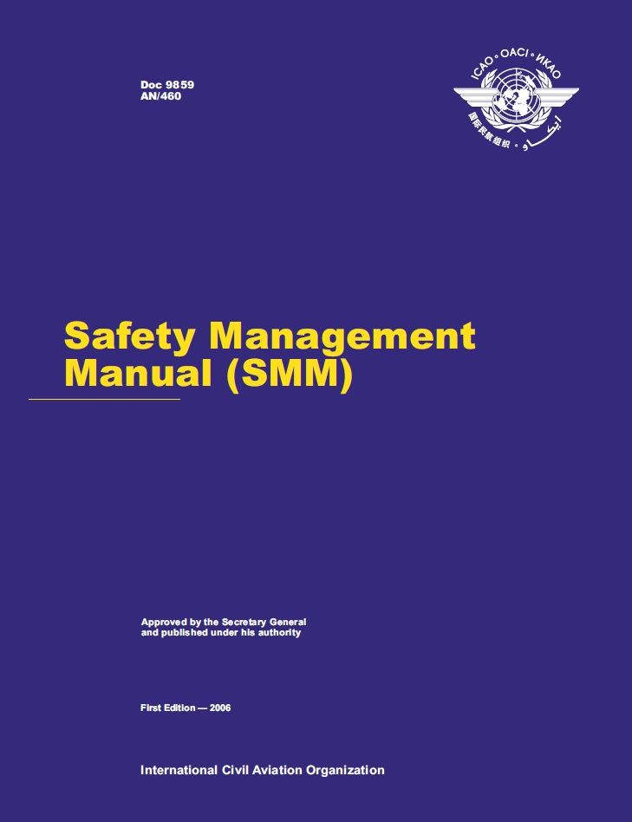
Safety Management Guidance Material
Safety Management Manual (SMM) third Edition, Doc 9859, was published on 8 May 2013:
Restructured according to the SSP and SMS Frameworks.
Detailed guidance and tools for SSP and SMS implementation
A presentation, SMM 3rd Edition Highlights, identifying the main differences between 2nd and 3rd editions of the SMM (Doc 9859) can be accessed here.

Slide 33
Training Material
The ICAO safety management training material is being updated to reflect the 1st edition of Annex 19 and the 3rd edition of the SMM, and is expected to be completed in 2014.
In the interim, a supplementary module highlighting the changes introduced by Annex 19 and the 3rd edition of the SMM has been added to the ICAO safety management training courses.

Slide 34
ICAO Safety Management Public Website
In order to support the implementation of safety management provisions, the ICAO Safety Management public website has been updated and contains:
History and overview of ICAO safety management provisions;
List of safety management guidance material;
ICAO safety management tool kit;
Links to safety management material developed by other organisations;
Information on how the USOAP will address safety management provisions;
Annex 19 promotional material
Latest developments; and
Frequently Asked Questions (FAQs).
For further information, refer to: http://www.icao.int/safety/SafetyManagement

Slide 35
Access to ICAO Documentation
FOR ICAO Member State’s Civil Aviation Administration and governmental bodies/agencies involved in non-commercial aviation activities
Free access is provided to all ICAO State Letters and saleable documents through the ICAO Portal (ICAO NET). Click here to download instructions for obtaining access to ICAO NET.
FOR ALL OTHERS
Annex 19 is available for purchase in hard copy or electronic format through http://store1.icao.int/ or Email at sales@icao.int

Slide 36
Support for Annex 19 implementation
Annex 19 – Safety Management

Slide 37
Support for Annex 19 Implementation
The Regional Aviation Safety Groups (RASGs) have been invited to identify activities, included required resources, to support the Annex 19 roll-out plan and the effective and continuing implementation of SMS and SSP provisions.
The States, through their RASGs are strongly encouraged to report progress, regarding the implementation of SSP and SMS provisions, which is essential to guide the future development of safety management provisions (Phase 2)

Slide 38
The future development of the safety management SARPs Annex 19 – Phase 2
Annex 19 – Safety Management

Slide 39
Annex 19 Development – Phase 2
As previously explained, the development of Annex 19 was split in two phases:
Phase 1, which was completed with Annex 19, 1st edition; and
Phase 2, which focuses on the development of new requirements and further guidance material.
ICAO continues to work in close collaboration with its Member States and international organizations on the development of safety management provisions.
Many of the comments received and issues identified during Phase 1 are addressed in the on-going work programmes of the SMP and/or other groups of experts.

Slide 40
Annex 19 Development – Phase 2
The on-going safety management work programme includes:
Development of amendments to SSP provisions
Development of amendments to SMS provisions
Development of emergency response plan provisions;
Enhancement of provisions for the collection, analysis and protection of safety data and safety information;
Further development of SMS and SSP implementation and assessment tools;
Extension of the applicability of the SMS provisions; and
Enhancement of provisions for the integration of SMS and SSP activities
Notes:
To illustrate
Determine relationship between SSP and Safety Oversight
Provide additional recommendations regarding emergency response
The need to address scalability issues
Introduction of SMS provisions for engine and propeller design and manufacturing org.
Provide harmonized acceptance criteria for SMS implemented by training organizations and AMOs
Additional SARPs or guidance based on recommendations from the Safety Information Protection Task Force (SIP TF)
Evolution of the Attachments in Annexes 13 and 19 containing Legal Guidance on the Protection of Safety Information
clarify SMS requirements for secondary service providers, i.e. de-icing activities provided by an aerodrome , ground handling services for the operator.
The outcome will be the next iterations of Annex 19 and the SMM (guidance material)

Slide 41
Annex 19 Development – Phase 2
Future amendments to Annex 19 are expected to follow a three year amendment cycle.
An impact assessment will be required for any proposed changes to Annex 19 provisions to ensure stability and continuity in the implementation of SSP and SMS for all States.
While overarching safety management SARPs will be included in Annex 19, new sector-specific management provisions are expected to be included in the appropriate Annexes.

Slide 42
Any questions should be addressed at SafetyManagement@icao.int

